Slide 1

32e Journée DIP – ISDC (4 & 7 May 2021)
New Developments in Private International Law in East Asia
New Developments of Private International Law in Japan
Yuko Nishitani
(Professor at Kyoto University, Japan)

Slide 2

Introduction
New developments of PIL in Japan in relation to East Asia
Nationalization
Regionalization
Internationalization

Slide 3



I. Nationalization

Slide 4
I. Nationalization
General Remarks
1868 Meiji Restauration = Modernization of Japan
1898 Hôrei (Choice of Law Rules): catch up with the „West“
1989 Reform of Hôrei in Family Law (Gender Equality)
2001- „Judicial Reform“ (deregulation) = Statutory Reforms
2006 Act on General Rules for Application of Laws
2011 International Jurisdiction in Civil and Commercial Matters
2018 International Jurisdiction in Personal Status and Family Matters
Cf. Developments in Europe
1987 Swiss PIL Act
Brussels/Lugano System
EU Regulations

Slide 5
I. Nationalization
2. Choice of Law Rules
Act on General Rules for Application of Laws (AGRAL) (Act No 78 of 21 June 2006): successor of Horei
Family Law
Principle of Nationality vs. Principle of Habitual Residence/Domicile (EU; Switzerland; Mainland China)
Contracts
Art. 7: Party Autonomy
Art. 11 & 12: Consumer and Employment Contracts
→ Invocation of mandatory rules by consumer/employee (Cf. Art. 6 & 8 of the EU Rome I Regulation: ex officio application)
Torts
Art. 17: Locus damni (if foreseeable)
Art. 18 & 19: Product Liability & Defamation
Art. 22: “Double Actionability”
→ Cumulative Application of Japanese Law (outdated)
To exclude US punitive damages

Slide 6
I. Nationalization
3. Jurisdiction Rules in Civil and Commercial Matters
Reform of the Code of Civil Procedure (CCP)(Act No 36 of 2 May 2011)
Based on previous case law
Art. 3-2 CCP: General jurisdiction at defendant‘s domicile
Art. 3-3 CCP: Special jurisdiction: place of performance, place of tort etc.
Art. 3-7 CCP: Choice of court agreements
→(Unlike Brussels/Lugano system) Other broad jurisdiction grounds:
Defendant’s situs of assets
Joinder of claims or parties
No exclusive jurisdiction for rights in rem in immovables
→To deter exorbitant jurisdiction: “special circumstances” test (a Japanese version of forum non conveniens) (Art. 3-9 CCP)
Unique structure proper to Japan

Slide 7
I. Nationalization
4. Jurisdiction Rules in Status and Family Matters
Reform of the Personal Status Litigation Act (PSLA) & Domestic Relations Case Procedure Act (DRCPA)) (Act No 20 of 25 April 2018)
Based on previous case law
Jurisdiction grounds in divorce cases (Art. 3-2 PSLA):
(i) Defendant‘s domicile
(ii) Spouse‘s last common domicile
(iii) Japanese nationality of both spouses
(iv) Plaintiff‘s domicile when justified under „special circumstances“ (e.g., defendant‘s unknown whereabouts)
→ Narrow jurisdiction grounds: Defendant’s right to be heard
Japan should have followed the European model (favor divorce & status stability)
Cf. EU & Switzerland: Broader jurisdiction grounds
Plaintiff’s habitual residence/domicile or nationality

Slide 8



II. Regionalization

Slide 9
II. Regionalization
1. Diverse Jurisdictions in East Asia
Japan
People’s Republic of China/Mainland China
Hong Kong Special Administrative Region (SAR)
Macao Special Administrative Region (SAR)
Republic of China (Taiwan)
Democratic People’s Republic of Korea (North Korea)
Republic of Korea (South Korea)
Philippines
Thailand
Malaysia
Singapore
Indonesia etc.
Unrecognized State/Government
Civil Law vs. Common Law
Secular Law vs. Religious Law

Slide 10





II. Regionalization
2. Non-Recognition of State/Government
People’s Republic of China
Republic of China (Taiwan)
Republic of Korea
Democratic People’s Republic of Korea (North Korea)
Applicable Law: Qualify → National Law of Koreans?
Double Nationality or Multi-unit State
→ Closest Connection + Sense of Belonging
(2) Copyright Protection for North Korea? (denied)
Supreme Court of Japan, 8 December 2011
North Korean authority Japanese TV company
Licensed Japanese company
- Membership of Japan at the Berne Convention since 24 April 1975; North Korea since 28 April 2003
- Treaty obligations only for universal obligations under general international law; not applicable to the Berne Convention

Slide 11
II. Regionalization
3. Compensation for WWII
Supreme Court of Japan: Claims of victims against Japanese government or companies refused (Supreme Court of Japan, 29 Nov. 2004 (comfort women); 9 Oct. 2003, 27 April 2007 (forced workers) etc.)
1965 Settlement Agreement between Japan and South Korea; 1972 Joint Communique between Japan and the People‘s Republic of China
No pre-war state liability; Statute of limitation
Supreme Court of the Republic of Korea, 30 Oct. 2018 (Shin-Nittetsu), 29 Nov. 2018 (Mitsubishi-Jukogyo), etc.: Forced workers vs. Japanese companies → Execution being prepared
Seoul Central District Court, 8 Jan. 2021 = 12 comfort women vs. Japanese government, damages granted (no execution)
Seoul Central District Court, 21 April 2021 = Immunity of Japan
← 28 December 2015: Agreement between Japan and South Korea payment of $100,000 for comfort women, but no final solution
No Mutual Recognition of Judgments Diplomatic Solution will be necessary

Slide 12
II. Regionalization
4. Reciprocity for Judgments Recognition
Japan: Art. 118 No. 4 CCP („Essentially equivalent conditions“: South Korea, Singapore, Germany, France, Switzerland, U.K., U.S., Australia etc. + Hong Kong SAR)
Mainland China: Art. 282 CCP (Treaty or Reciprocity except divorce cases)
Dalian Intermediate People‘s Court, 5 Nov. 1994 (“Gomi Akira”); Reply of the Supreme People‘s Court (SPC) of 26 June 1995 = No enforcement of Japanese judgments (×Reciprocity)
Osaka High Court, 9 April 2003 = No recognition of a Chinese decision confirming the investor status (×Reciprocity)
Tokyo High Court, 25 Nov. 2015 = No enforcement of a Chinese judgment ordering damages for defamation (×Reciprocity)
2016- Mainland China: „De facto Reciprocity“ Singapore, the US, the Republic of Korea based on a precedent (Cf. 2013 Wuhan IPC: recognized a German court decree)
Reciprocity: State interests, risk individuals‘ rights
Generous interpretation is desirable

Slide 13
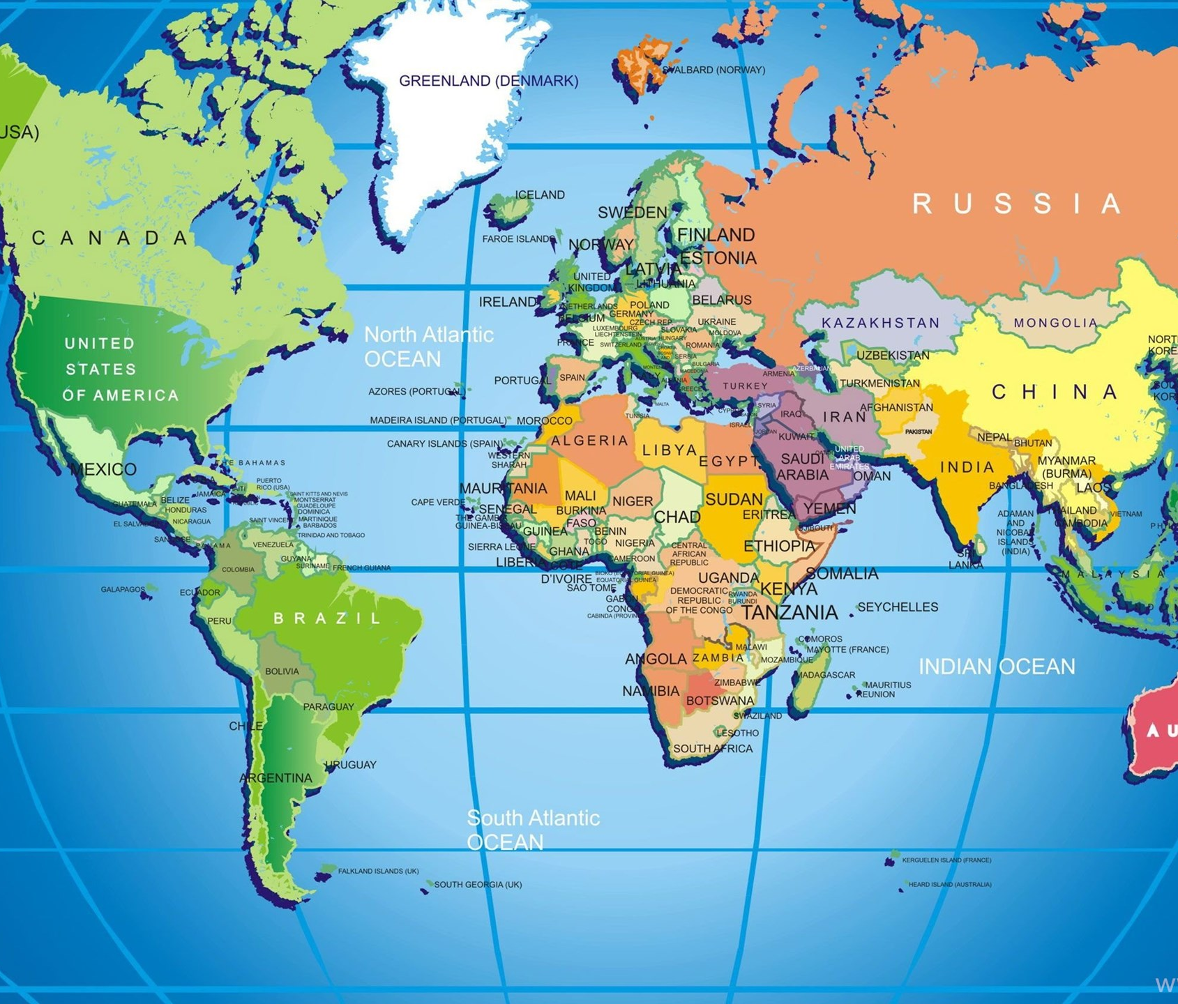


III. Internationalization

Slide 14
III. Internationalization
Recognition and Enforcement of Judgments
No reciprocity between Japan and Mainland China
No judgments recognition without treaty in Indonesia and Thailand; restricted in Cambodia, Myanmar, the Philippines and Viet Nam
2005 HCCH Choice of Court Convention (32 parties) 2019 HCCH Judgments Convention (no parties; 3 sig.)
Arbitration and Mediation
Business often prefers arbitration & mediation
1958 New York Convention on Foreign Arbitral Awards (168 parties) 2018 Singapore Convention on Mediation (6 parties, 47 sig.)
MOJ of Japan: Legislative Sub-Committee on Arbitration (provisional measures[2006 amendment UNCITRAL Model Law on Arbitration]; enforcement of settlement agreements resulting from mediation)
→ Compete with Singapore or Hong Kong?

Slide 15
III. Internationalization
3. 1980 Child Abduction Convention
East Asia: Hong Kong SAR (1997) & Macao SAR (1999); Thailand (2002); Singapore (2011); South Korea (2013); Japan (2014); the Philippines (2016)
→ Implementation in Japan
Amicable solution about 60%
Issues: habitual residence; grave risk; “change of circumstances”; habeas corpus order
Enforcement strengthened since 1 April 2020 (Act No. 2 of 17 May 2019)
8 July 2020 European Parliament Resolution
Urging Japan to abide by the 1980 Child Abduction Convention & 1989 UN Convention on the Rights of the Child
Ensure Return & Access/Visitation
Introduce Joint Custody after Divorce
→ MOJ of Japan: Legislative Sub-committee on Family Law deliberating a legislative reform accordingly (since March 2021)
Importance of International Cooperation

Slide 16

IV. Conclusion

